Slide 1
Announcements
Cool things in the world of Angular
December, 2013
http://goo.gl/JuexWu

Slide 2

3 AngularJS Releases!
AngularJS 1.2.2
Highlights:
91 PRs and issues closed!
Many animation fixes
Performance improvements for data-binding and $parse
AngularJS 1.2.3
AngularJS 1.2.4

Slide 3
1 AngularDart Release!
AngularDart 0.9.2
Highlights:
28 PRs and issues closed!
Ternary operator and integer division in template expressions
Performance improvements with early exit of digest loop, lazy scope digest and skipping auto-digest
Experimental support for ng-shallow-repeat

Slide 4
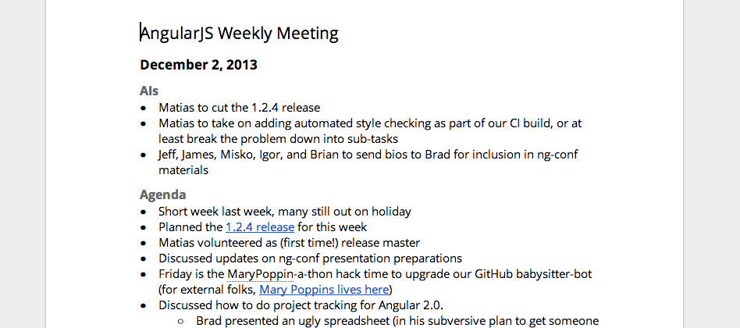
Now, with notes!
AngularJS Weekly Meeting Notes

Slide 5


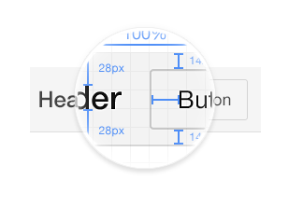
Ionic mobile framework
ionicframework.com/

Slide 6
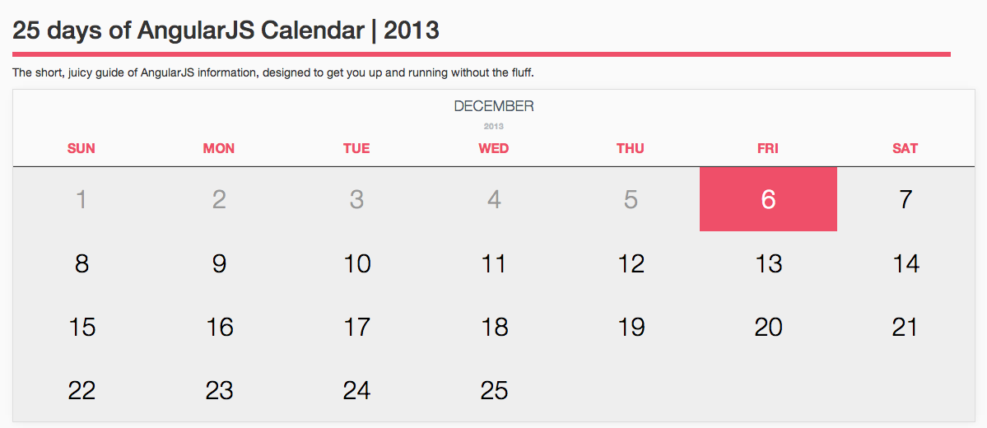
25 Days of Angular
www.ng-newsletter.com/advent2013

Slide 7

Google Developers Livestream
Building Chrome Apps with AngularJS
Apps with AngularJS
Dec 12, 9AM PDT

Slide 8
Thanks!
http://goo.gl/JuexWu

